Slide 1
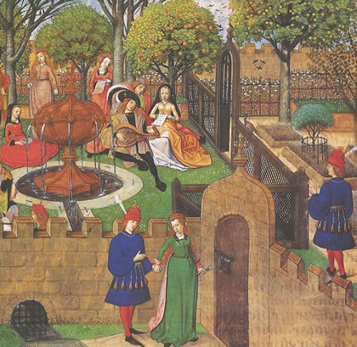
Medieval Ages
Transition period between Ancient and modern times
Also called the Middle Ages

Slide 2
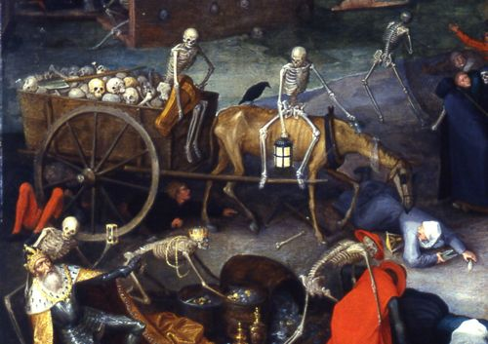
Dark Ages
Early part of Middle Ages
Western Europe backward because of decline
Concern about powerful Muslims

Slide 3
Signs of Vitality in medieval western culture following the Fall of Roman Empire
Strong spirituality
Population growth
capitalism
Developments of university
Development of new political and social structures
New architecture forms
The center of post-classical west
Central plains of northern Europe
Low countries
South and west Germany

Slide 4
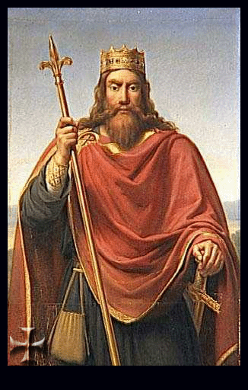
Franks
Germanic tribe that united under King Clovis (5th century)
First Germanic ruler to accept Christianity
Establish capital at Paris
Frankish kings followed the custom of dividing kingdom among heirs the empire will decline

Slide 5
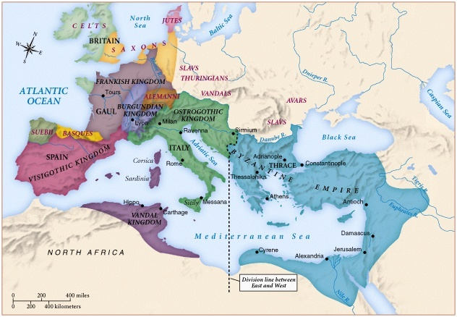
Europe in 6th century

Slide 6
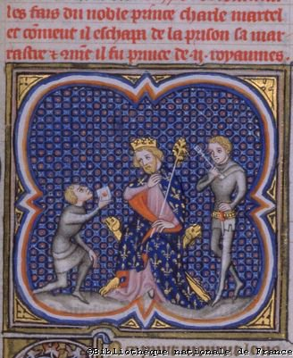
Mayors of the Palace
By 700 AD power went from kings to government officials known as mayors of palace

Slide 7
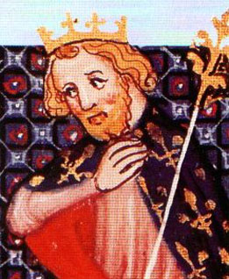
Charles Martel
Won the Battle of Tours
Battle that stop the spread of Islam into Western Europe
Founded the Carolingian Dynasty
8th Century Frankish monarchy
Will try to reunite the region under his control

Slide 8
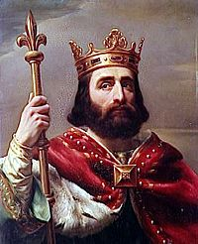
Pepin The Short
Son of Charles Martel
Chooses to have his succession certified by the Pope
Significant because it sends a signal that an empire’s legitimacy rested on Roman Catholic church approval
Took land away from Lombards
Gave land to the church creating the Vatican states
Notes:
Built a large kingdom but not an empire by historical standards

Slide 9
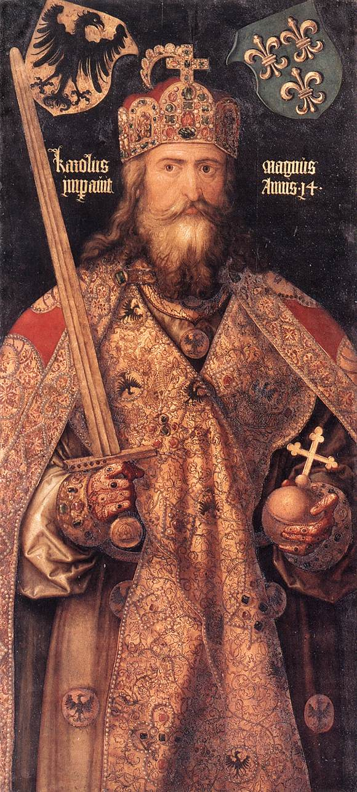
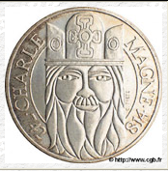
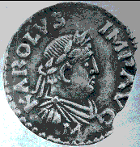
Charlemagne
First time since the Fall of the Rome western Europe ruled by one government
800 CE
Wanted to revive learning
Study based on Bible and Latin writings

Slide 10
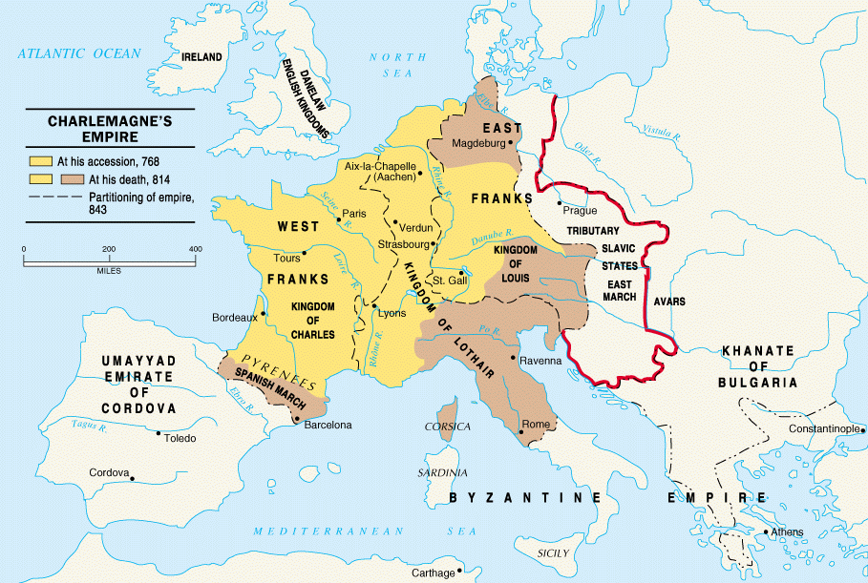

Slide 11
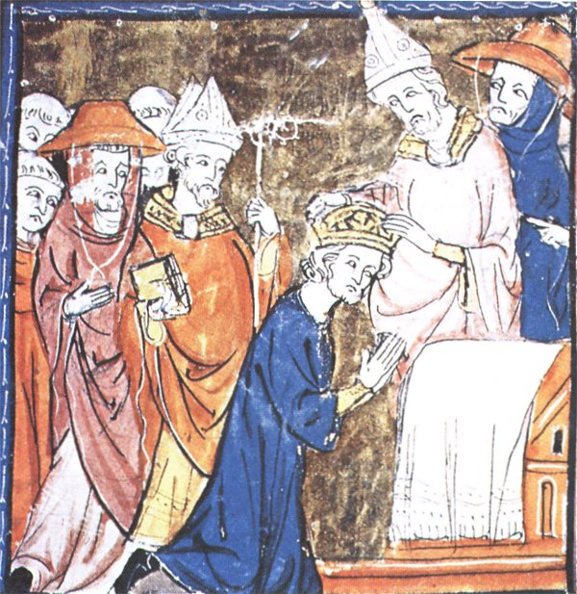
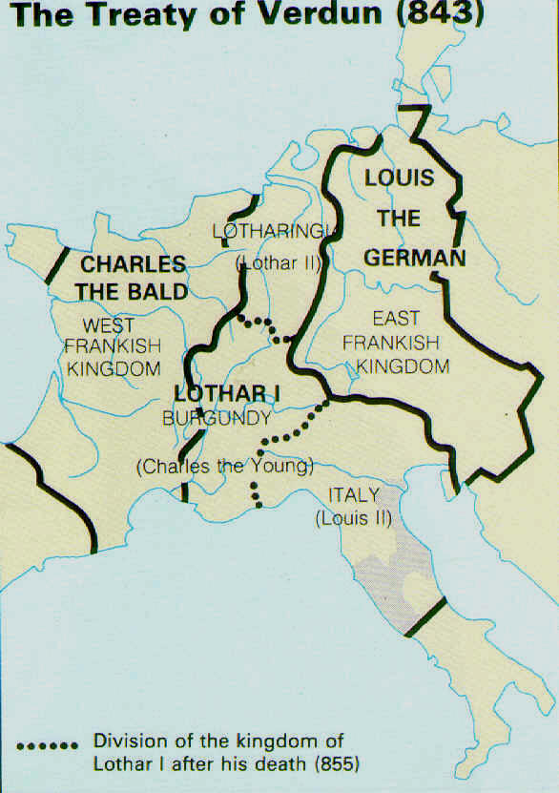
Defend Pope Leo III
Crowned New Roman emperor as reward
His personality holds empire together
Empire divide by Treaty of Verdun upon his death

Slide 12
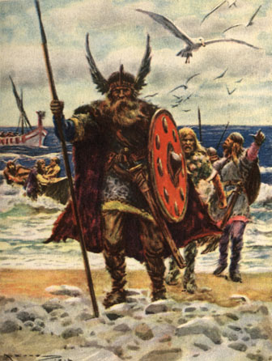
Europe will come under attack by
Vikings (Scandinavia) and Magyars (Hungary)
Disrupt the political scene
Vikings most successful
Boats- multi oared, highly maneuverable
Vikings had limited resources so turn to raiding
Natural targets were monasteries
Wealth and plenty of food

Slide 13
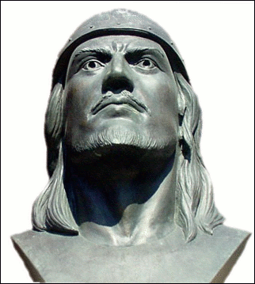
Vikings
Vikings were also merchants and fishermen
New settlements in Newfoundland, Canada, Russia and France
In France the Vikings were known as Normans
Leif Ericson
Viking who most likely explored North America 500 years before Columbus
Vikings will convert to Christianity
Will assimilate to areas they invaded because of the religion

Slide 14
Between 9th and 10th century
Positive
End of Viking raids
New farming practices
More political stability in region
Towns serving as trade centers

Slide 15
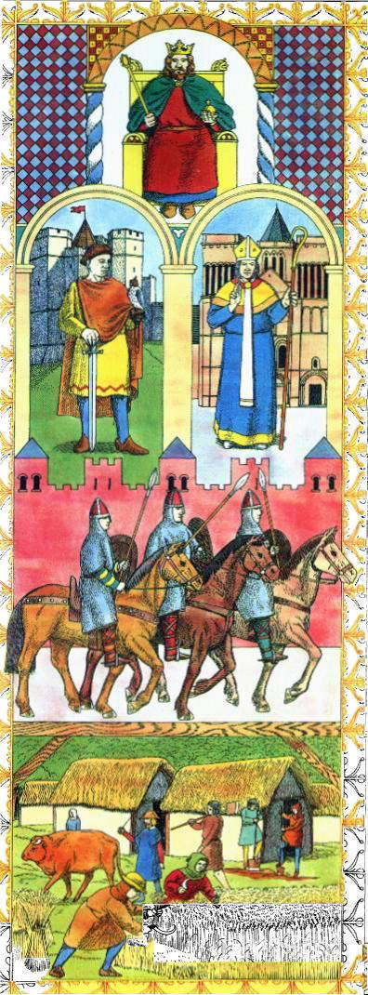
Feudalism
Highly decentralized form of government
Inhibit development of strong central states but some kings will use to their advantage
Stress alliances of mutual protection

Slide 16
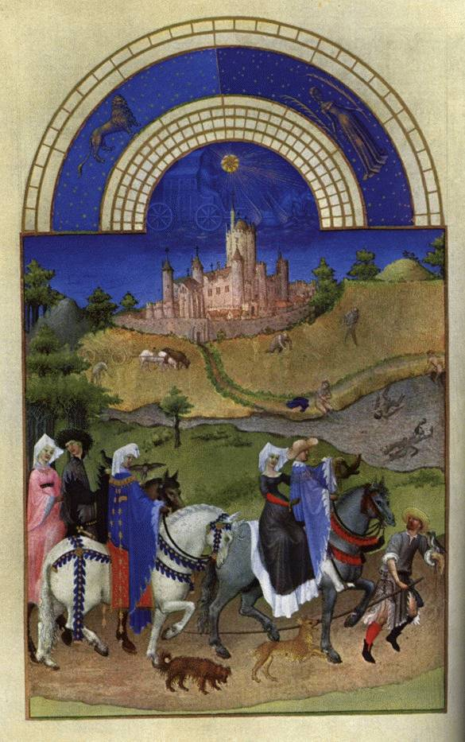
Based on giving land to nobles in exchange for loyalty and military aid
One who received land called a vassal
Lord- a vassal to the king
Only had direct contact with king when called upon by the king
Rest of time was in charge of his own life and manor
Conflict often arose between the Lords
Word -- Feud

Slide 17
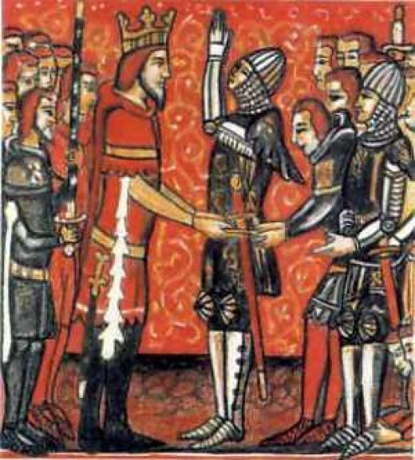
Land was called a fief
Fealty was the oath of loyalty to the lord
Homage was the ceremony in which the oath was taken
Could swear loyalty to more than one lord

Slide 18
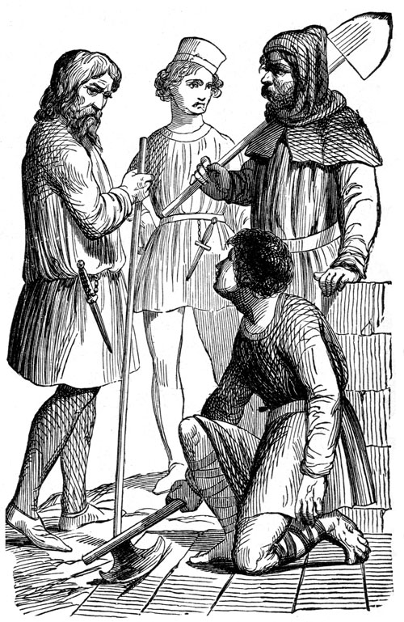
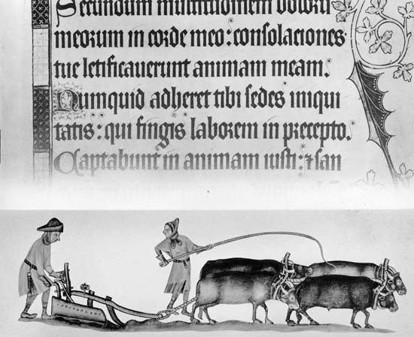
Land came with peasants called serfs
Bound to the land
Could not be sold apart from the land
Different from slaves- who can be sold away from the land
‘Imprisonment’ on land led to the serfs becoming highly skilled workers
Learn how to do what every it takes to make the manor self sufficient

Slide 19
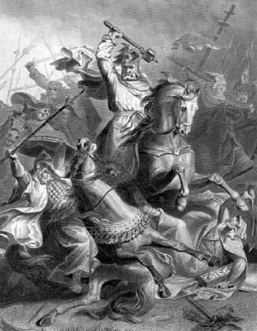
Beginning of feudalism trace back to Charles Martel
Desire for stirrup and cavalry
To receive land Vassal had to pledge certain duties
Military service
Pledge to pay ransom in event the Lord capture

Slide 20
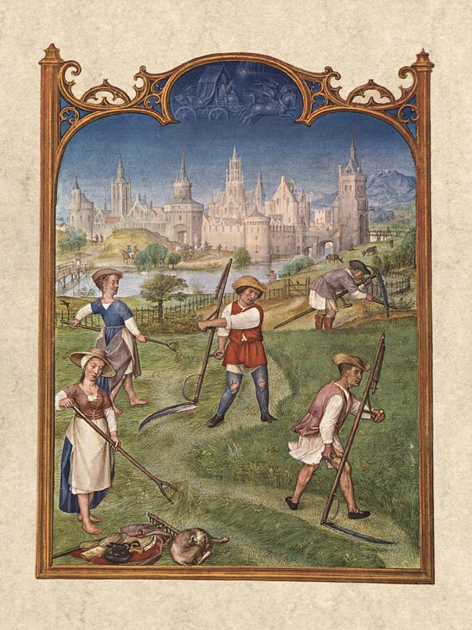
For Feudalism to work, everyone had to meet their obligations at their level of the hierarchy
Serve in military
Produce food
Or serve those at a higher level

Slide 21
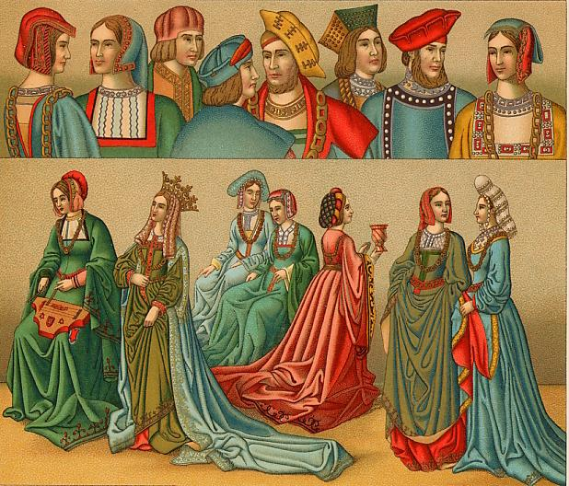
Feudal system was male-dominated
Land equal power and only males could inherit
Women were powerless
Noblewomen had few rights
Were socially elevated
Could inherit fief but could not run it
Education limited to only domestic skills
But admired for beauty and compassion
Regarded as property to be protected and displayed
Primogeniture
Land and title are passed down to eldest son

Slide 22
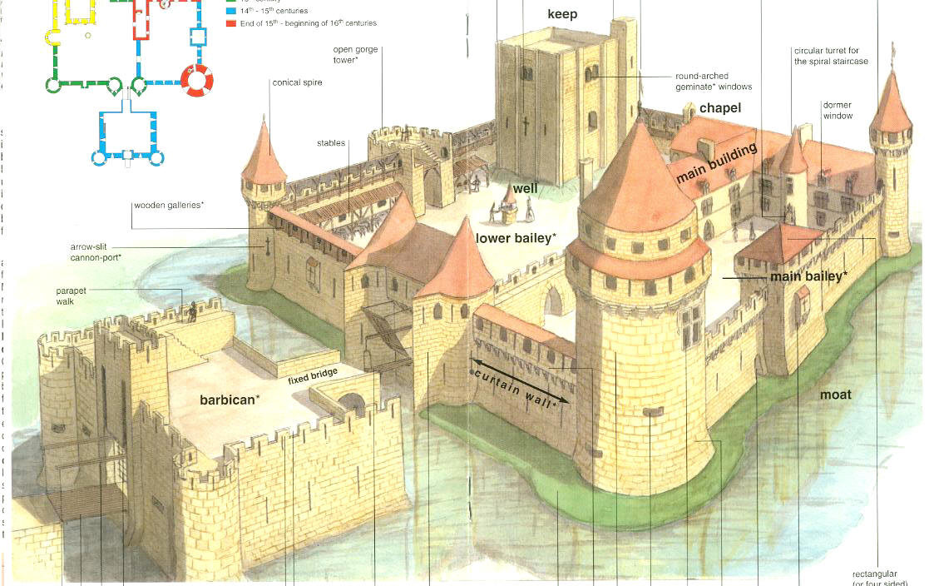
Castles
Because of lack of strong central government , warfare often
Results castles built
Fortified manor houses
Parts of castles
Turrets- small towers
Moats- deep ditches around castle
Keep the strongest part of the castles
Dungeon- prison
Guarder robe- restroom

Slide 23
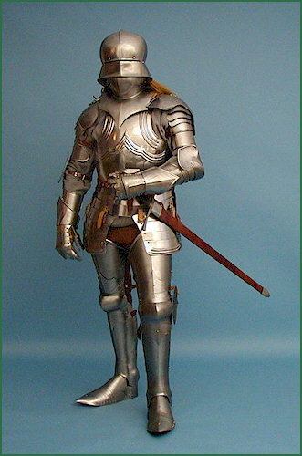
Knights
Warriors pledged by the vassals to the Lords
Very expensive to train
Stages for knighthood
Page- age 7
assistant to the lord
learn manners
use of weapons
Squire – age 15
assistant to knights
Knight
After prove oneself in battle

Slide 24
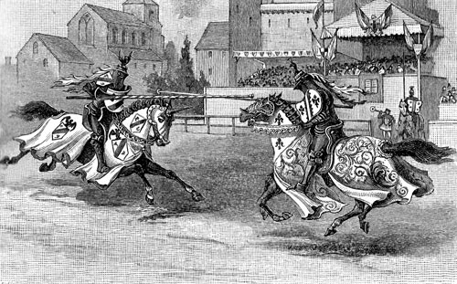
Tournament- help knights practice skills

Slide 25
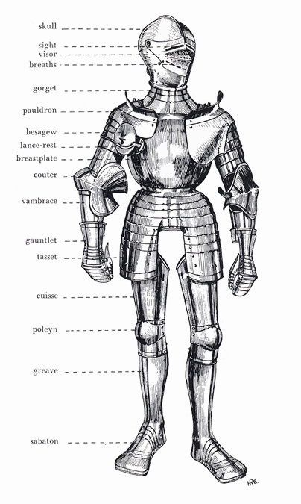
Armor- used to protect knights
Over 30 different pieces

Slide 26
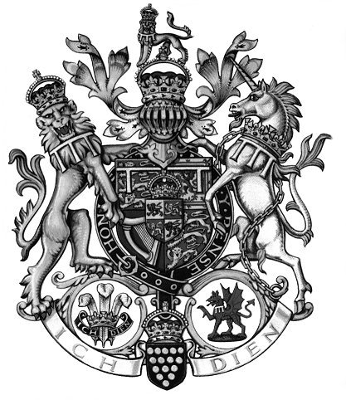
Coat of arms-Use to identify the knights

Slide 27
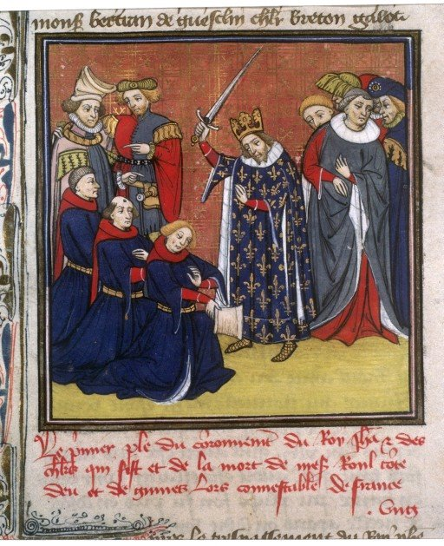
Dubbing-Ceremony of becoming a knight

Slide 28
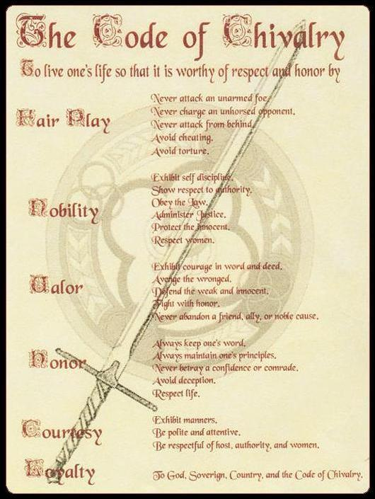
Chivalry- Code of conduct for knights
Be brave in battle
Fight fairly
Defend the church
Treat women of noble birth in courteous manner

Slide 29
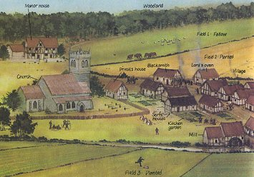
Manorialism
Economic system of Middle Ages
Political and economic relationship between landlord and peasants
Manor
Lord’s house/castle, church and farm land
Self sufficient- produce all needs
No trade

Slide 30
Manorial system was
Start in the Roman Empire
Practically self sufficient
Serfs – obligations great
Agricultural productivity was low
Land was cultivate on vast manorial estates which were divided into the lord’s demesne
Area of land reserved for the lord and tracts reserved for the peasants

Slide 31
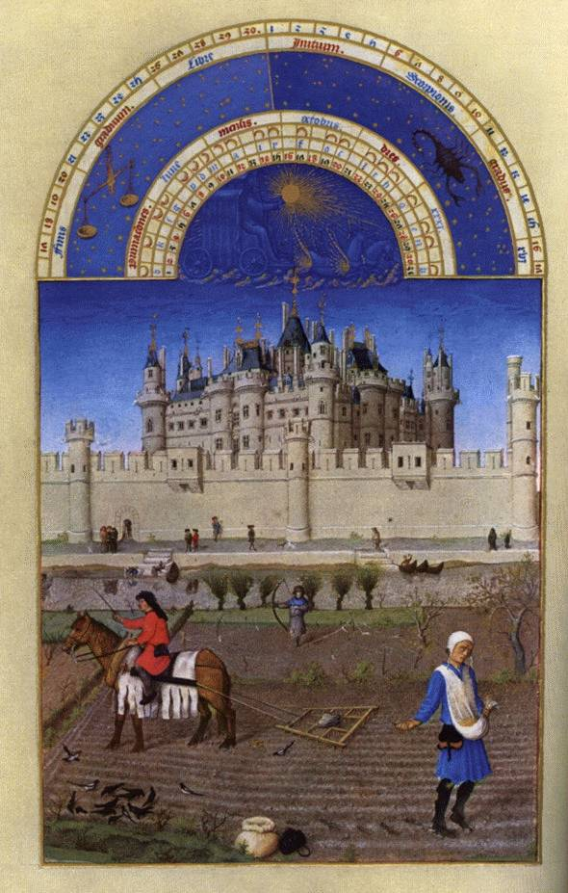
System of dividing the land into two or three tracts is known as the open field system
Crop rotation make land more productive
Added acres to production by leaving only a third of the land unplanted
Introduction of a better iron plow called moldboard
Allowed for deeper cultivation of field

Slide 32
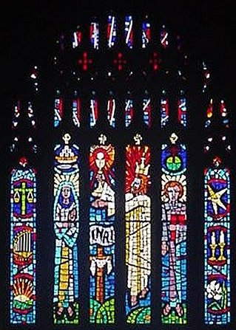
Catholic Church
Center of life
Pope became the strongest political leader of Western Europe
Taught that all people
sinners and dependent on God’s grace or favor
Believed that church had authority separate and above that of secular rulers
the church controlled about 1/3 of the land in Western Europe

Slide 33
Powers of Pope
After 500 CE
Regulation of doctrine
Missionary sponsorship
Excommunication
Directives
Did not appoint bishops

Slide 34
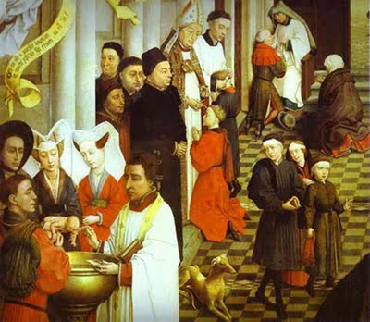
Only way to receive grace was by taking part in sacraments
Church rituals- baptism, penance, Eucharist, confirmation, matrimony, holy orders and last rites

Slide 35
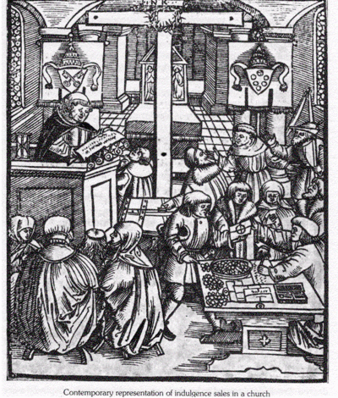
People had limited understanding of church rituals
Masses in Latin
Priest often uneducated and not effective in their preaching

Slide 36
Average person learn about Christianity from statutes, paintings and stain glass windows

Slide 37
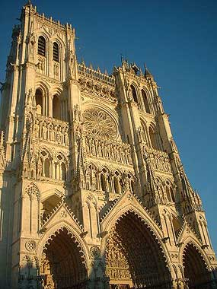
Cathedrals
Over time became more than a place of worship
Became a place of art form and a place of art
Church sponsor artists – paintings and sculpture

Slide 38
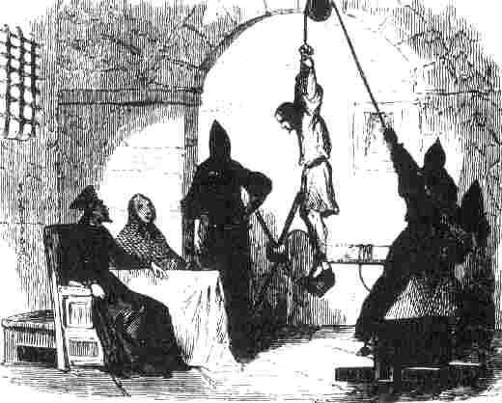
Powers of Church
Disobedience- severe punishment regardless of social status- king or peasant
Interdict-
banned an entire region or country from receiving the sacraments necessary to salvation

Slide 39
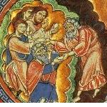
Tithe-
expect to pay 1/10 of their income to the church
Peter’s Pence
1 penny per person [paid by the peasants].
Often largest land owner next to king

Slide 40
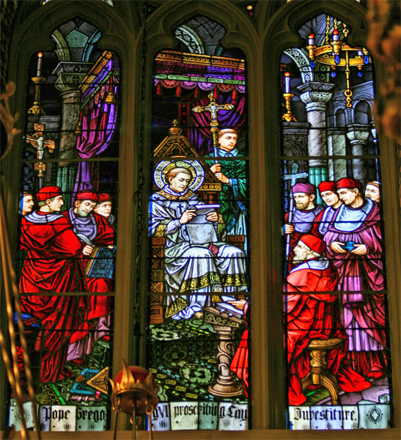
Pope believe that the church should be the final authority
Want to be free of outside influence
Change in way that Pope will be chosen
No longer chosen by political leaders but elected by group of high church officials called Cardinals

Slide 41
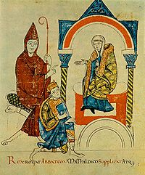
Pope especially concern about Lay investitures
Investiture is the practice of state appointing bishops
Secular rulers would give symbols of office
Ring or staff
Often to win loyalty

Slide 42
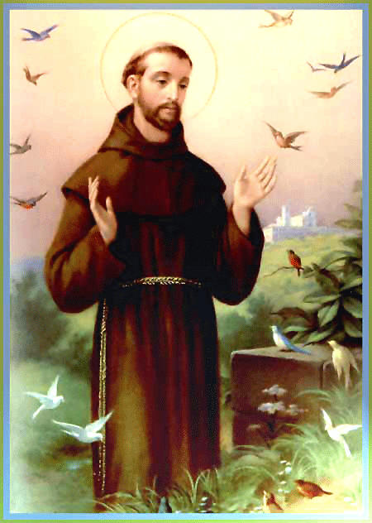
Monasteries
Prayer and religious discipline
Provided some education
Promoted literacy
St. Benedict –
Benedict of Nursia
Benedictine Rule of poverty, chastity, and obedience.
Rules for monasteries
inns, hospitals, refuge in times of war.
libraries & scriptoria to copy books and illuminate manuscripts.
St. Francis of Assi
Founder of the Franciscans
monks → missionaries to the barbarians. [St. Patrick, St. Boniface]

Slide 43
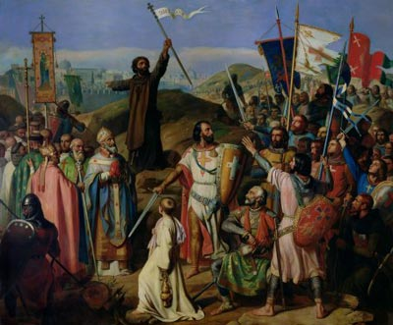
Crusades
Series of holy wars fought over control of Jerusalem
Jerusalem is a holy city for 3 faiths
Jews, Christians and Muslims

Slide 44
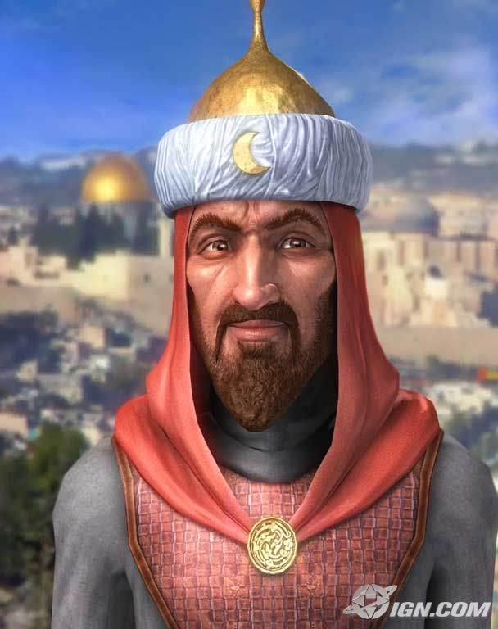
Holy Land
Under control of the Muslims Turks who began to interfere with religious pilgrims traveling to Jerusalem
Saladin
Leader of the Muslim during the Crusades

Slide 45
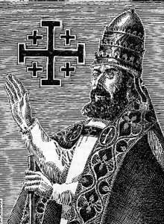
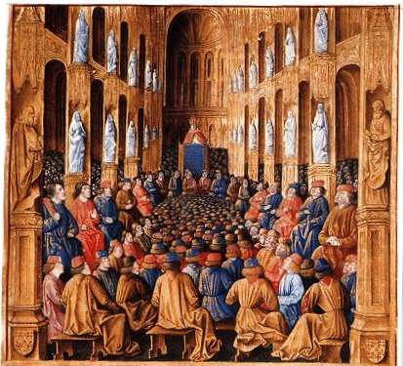
Pope Urban II calls for a volunteer army to free the holy land
Claiming that “ God wills it”

Slide 46
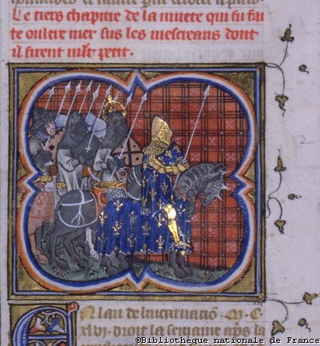
Why go?
Knights- chance to practice trade
Peasants- freedom from feudal bonds
Adventure
Promise of salvation if killed while fighting
Sew a red cross to their clothing as a symbol of service to god

Slide 47
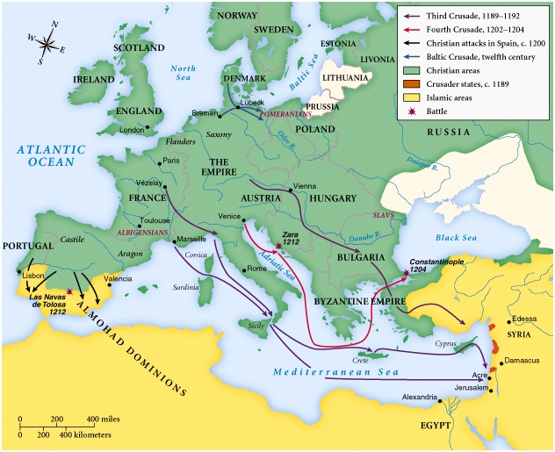

Slide 48
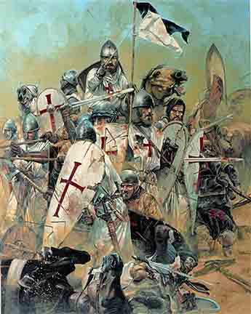
Results of the Crusades
Seven crusades
Holy land in control of Muslim Turks in the beginning and at the end.
Help to break down feudalism
Crusaders not always focus on religious goals
Sack of Constantinople
Fourth crusade

Slide 49
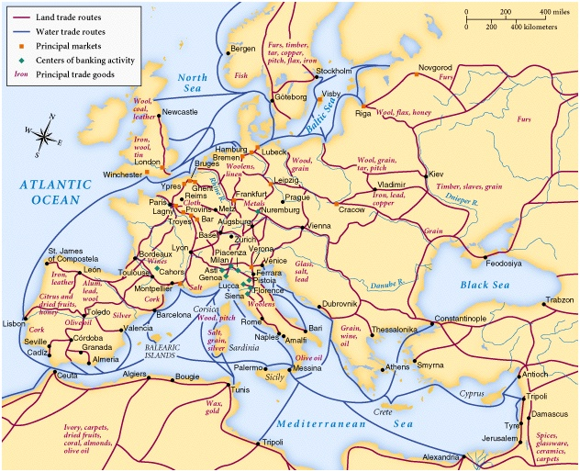
Contact with more advanced Byzantine and Muslims
Introduced to luxury goods
Trade

Slide 50
Europe contact with Muslims during Crusades & over trade routes will bring about new thought– People begin to question organized religion
Process of reasoning gave rise to heresy religious practices and beliefs that do not conform to traditional church doctrine
Sometime what was considered heresies were older beliefs that did not adapt to more mainstream changes in religious thought
Many heretics wanted to return to the simpler ways of early Christianity.
Reject how worldly and wealthy the church had become

Slide 51
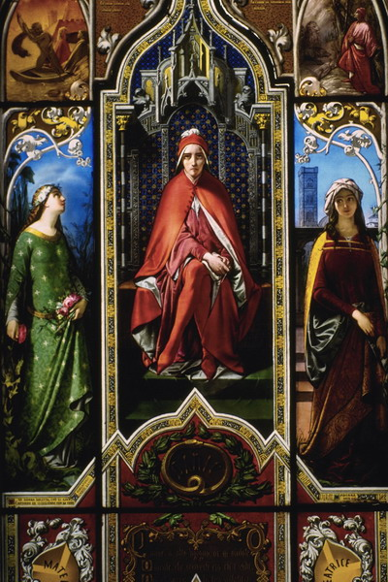
Art
Christian art reflected popular outlook and formal religious theology
Goal- serve the glory of God
Depicted saints
Medieval life used as backdrops
Stained glass in churches

Slide 52


Architecture
Combined Muslim design and Western engineering
Romanesque
Rounded Arches
Barrel vaults
Thick walls
Darker, simplistic interiors
Small windows, usually at the top of the wall

Slide 53



Gothic
Design to bring people closer to God
Soaring spires
Flying buttress
Support for tall arch windows and vaulted ceilings

Slide 54

Literature
Mostly Latin
Oral sagas and adventure stories
Show conflict
Christian values vs. richness/coarseness of life
Love became the first new value pursued

Slide 55

Dante Alighieri
Author of Divine Comedy

Slide 56


Chaucer
Author of the Canterbury Tales
Naughty stories that poke fun at institutions

Slide 57

England Monarchs
Alfred the Great
United the Anglo and Saxons to form England
Had scholars write the Anglo-Saxon Chronicles
History of England

Slide 58

William the Conqueror
Raised in France
Will inherit the throne but challenged

Slide 59

Wins throne in the Battle of Hastings 1066
Unpopular – gave land to French nobles who helped him win battle.

Slide 60

Domesday Book
Use as a census and for tax purpose

Slide 61

Henry II
Introduced the use of jury in English courts

Slide 62

King John
Unpopular king
Cruel
Lost land English control in France
Punish enemies without trial

Slide 63

Forced to sign the Magna Carta
One of the most important documents in history
Outlines the rights of commoners
Trial by jury
King under the law
No taxation without representation

Slide 64

Edward I
Created Parliament
Assembly of nobles
Represent views of different parts of England on lawmaking and taxation
Had decisions of the courts written down and used to establish common law

Slide 65

French Monarchs
Hugh Capet
Established the principle of eldest son inheriting the throne.
Make it easier to keep power because of not dividing kingdom among all sons

Slide 66

Philip IV
Established the Estate General
Legislative body
Under the firm control of the French kings

Slide 67

Holy Roman Empire Monarchs
Otto I
Tries to restore Charlemagne empire
Crown the Holy Roman Emperor for helping the Pope against Roman Nobles
Disputes between Church and Otto I & successors
Over Otto I claim they had the right to intervene in the election of Popes
Notes:
The Holy Roman Empire had little in common with the original Roman Empire, other than the fact that power was once again centralized and Rome began to think of itself again as a world center
The size of the Holy Roman Empire in comparison to namesake, was relatively small– northern Italy, Belgium, Germany and France
Marked the beginning of western European ambition in terms of empire-building, especially among those in the church

Slide 68

Henry IV
Quarrel with Pope over lay investitures
Resulted in Concordat of Worms
Allowed Emperor to name bishops and grant them land but also gave the Pope the right to reject unworthy candidates

Slide 69
Middle Class
Serfs had became skilled in trades
When Europe slowly began to trade with the rest of the world
Some serfs began to earn extra income
This will chip away at the rigid social stratification of the manor system
With banking- towns and cities gain
Result was “middle class”
people who made a living through the development of money economy
Urban craftsmen and merchants
Their success led others to come to cities to try to make more money
Europe was re-enter the world
No longer tied to the land

Slide 70

Towns
Expansion of Trade result of revival of towns

Slide 71

Towns were charter on lands controlled by feudal lords
Charter gave townspeople certain rights
Within towns, burghers (middle class merchants) became politically powerful
Like manors, towns had a great deal of independence in the empire but they were more interdependent

Slide 72
Towns will form alliances, not unlike city-states
One of the most significant was the Hanseatic League
Control trade in northern Europe
Effect of the interdependence of towns was
Initiate a drive toward nationhood
Increase social mobility and flexibility among the classes

Slide 73
Trade Fairs
At most convenient land and water routes
Most famous at Champaigne
Near center of Europe

Slide 74

Banks will cause the decline in feudal systems
Money changers-
Usually of Jewish faith
Against Roman Catholic beliefs of usury
Use to determine values of different currencies and exchange
Develop procedures for transferring funds, receiving deposits and arranging loans
First banks

Slide 75

Guilds
Business associates for merchants and artisans
Control quality of product
Limit membership
Regulated training
Control prices
Voice in local government
Positions
Control by masters
Artisans who owned their own shops
Apprentices
Work for master without pay to learn a craft
Journeymen
Work for pay under a master
Must submit a “masterpiece” of their work to become a master

Slide 76
Issues facing Western Europe at End of Middle Ages
Inability of farming to keep up with population growth
Bubonic Plague ( Black Death)
Social disputes
Between peasant-landowners
Artisan and employees
Development of technology and manufacturing

Slide 77
High Middle Ages Economy
Urban growth
Specialization of manufacturing and commercial activities (banking)
Some peasants escape Manorialism and became free farmers
Money economy replaced barter systems
Trade will result in redevelopment of commerce in Mediterranean

Slide 78


Universities
Important effect of people thinking more openly
Men study philosophy, law, medicine
Not tied into a single bureaucratic system
Learn from the advances made in Muslim culture
Ideas of Aristotle, Ptolemy and Greeks had been preserved by Muslims and Byzantine Empire
Trading and crusading
Progression was called scholasticism
Emphasized reason as well as faith in the interpretation of Christian doctrine
Will bring it into conflict with church

Slide 79
Development of universities after 1000 CE led to intellectual innovation
Peter Abelard
Use of logic to consider doctrinal issues
Bernard Clairvaux
Favored mysticism over rationalism
Similar to Islam
Introduction of classical authors
Lead to greater synthesis of rationalism and theology

Slide 80

Thomas Aquinas
significant inroads in altering Christian thought
Synthesis of rational philosophy with Christian theology
Author of Summa Theologica
Faith and reason are not in conflict
Both are gifts from God
Each used to enhance each other
Faith come first
Through reason, humans could find order

Slide 81

Black Death
Also called Bubonic plague
Spread by fleas on rats
Causes
Many people believed that God was punishing them
Some people believed that God was using the plague to end the world.
Nearly half of people of Europe will die from Black Death

Slide 82

100 Year War
Between France and England
Fought over English control land in France
France
larger population
fighting on own land
disadvantage of being disunited & poor tax system
England
had better weapons and training

Slide 83

Edward III
His claim to the French throne will cause the 100 Year War

Slide 84

Battles
Crecy
English victory
Use of firearm (cannon) and longbow
England made major mistake by not taking Paris after this battle
Will prolong the war

Slide 85

Joan of Arc
Appear at the low point for France in the war
Tells French king that she has heard voice of God telling her she will lead France to victory
Win a major battle at Orleans

Slide 86

Later capture by the English
Tried as a witch and burn at the stake
English hope this will break the French but instead unites them to victory.

Slide 87

Charles VII
Individual who Joan of Arc believes to be the rightful king of France

Slide 88
Effects of 100 Year War
France has a new sense of unity
England will be divided by conflict over lost of war
Hasten the decline of Feudalism
Replaced Knights with national armies
Paid armies

Slide 89



War of Roses
Civil War in England over the throne
Between two families
Lancaster (red rose)
York (white rose)
End when Henry (Lancaster) will marry Elizabeth of York
Form the Tudor dynasty

Slide 90

Church Reform
With the growth of educated middle class, people began to question church beliefs
Babylonian Captivity
Frenchman was elected Pope
Moved the papacy to Avignon France
Concern that the papacy would be dominated by French monarchs

Slide 91

Pope Clement V
Pope who move papacy from Rome to Avignon
Babylonian Captivity

Slide 92


Reconquista
Recon quest of Muslim areas in Spain
Ferdinand of Aragon and Isabella will united Spain
Will not compete with the Church but use it as an ally
Will end any religious toleration
Want all Spaniards to be Catholics
Order people to convert or leave
Will weaken Spanish economy

Slide 93

Establish the Spanish Inquisition
Court to enforce Catholic teachings
Torture anyone who suspect of heresy

Slide 94

Great Schism
French pope dies while visiting Rome
Cardinals elected an Italian pope but later claim that they did under duress
So they elect a French Pope
Two popes –each calling each other false pope
Elect a third pope hoping that other two would resign
Finally all 3 Popes forced to resign and other Pope elected.

Slide 95

Pope Martin V
Elected Pope to end the Great Schism

Slide 96
Women
Christian religion
Equality of souls
Convents
Veneration of Mary
Religious saints
But…. Eve as cause of original sin
Compared to Islam
Less confined to household
Less segregated in church services– but couldn’t lead
Urban women had role in commerce
Literature stressed women as docile/ supportive/ chivalry

Slide 97
Power of Kings end Middle Ages
Increases
Development of national armies
Growth of trained bureaucracies
Tax
Centralized legal codes and court systems
Limitations
Church could excommunicate kings
Limit powers of court
Creation of parliaments
Rights to approve taxation

